Slide 1

Competency Assessment Report
Name:
Target Position:

Slide 2
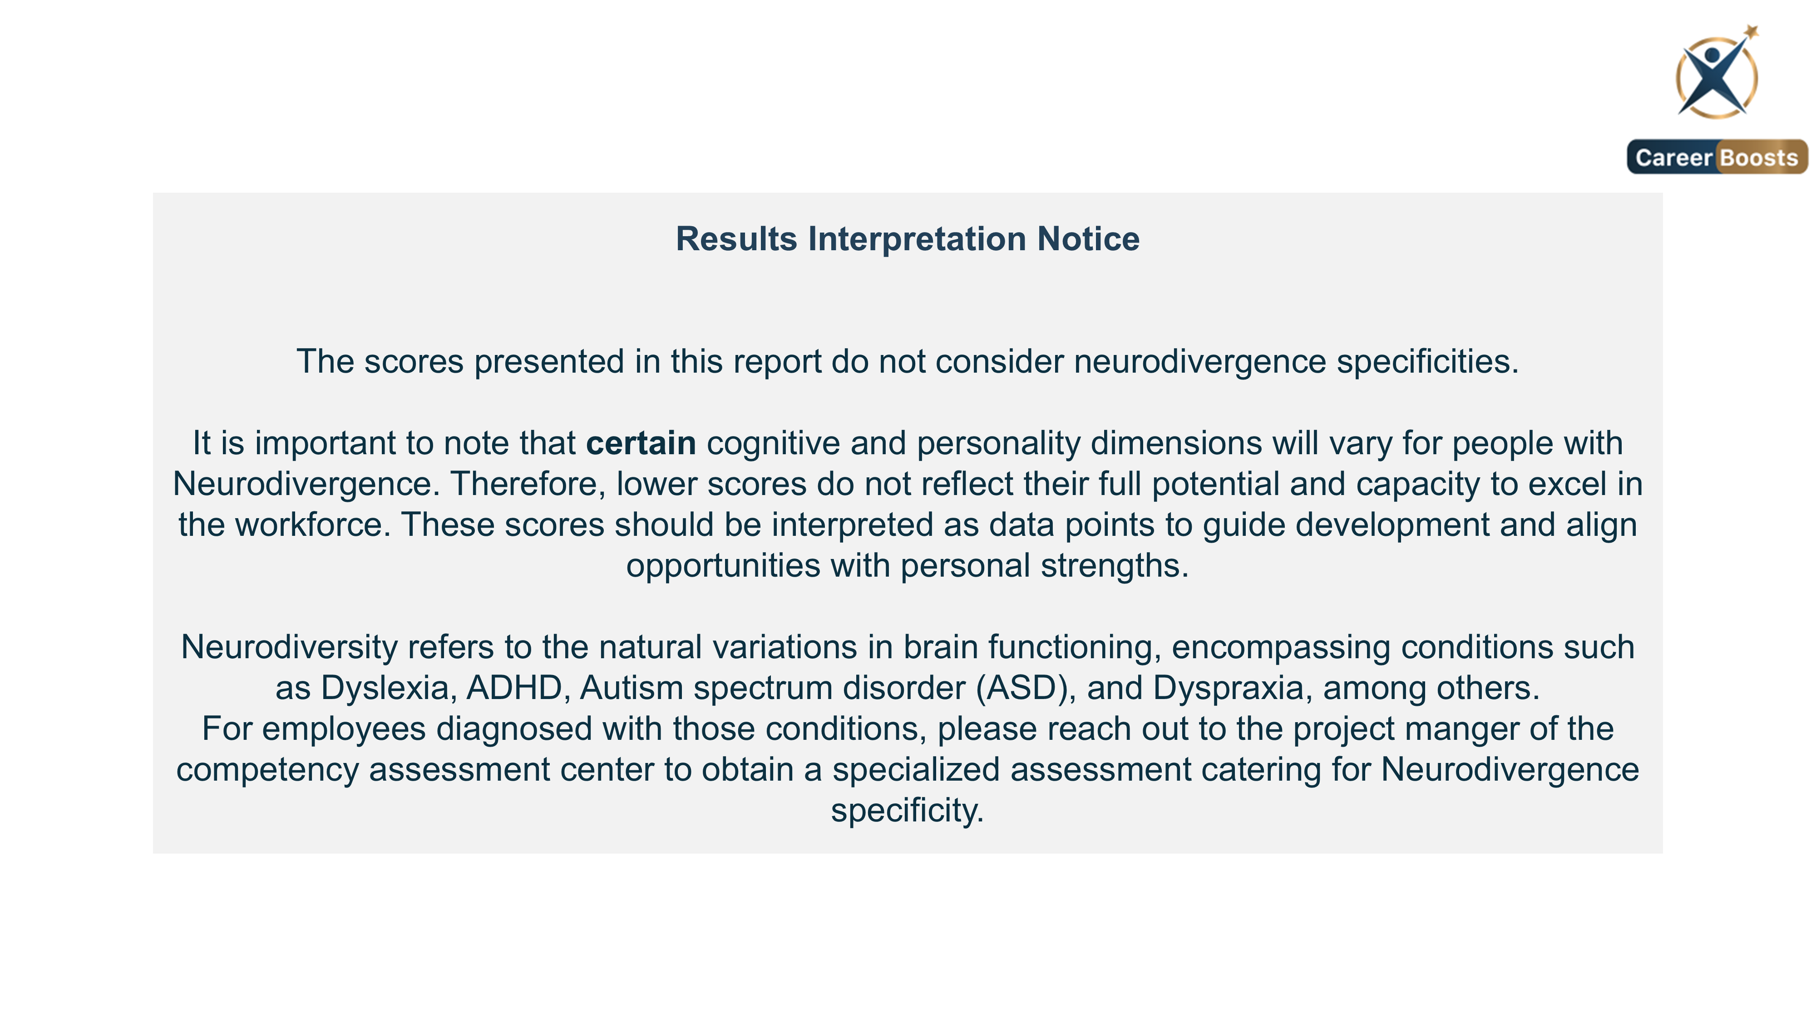
2

Slide 3
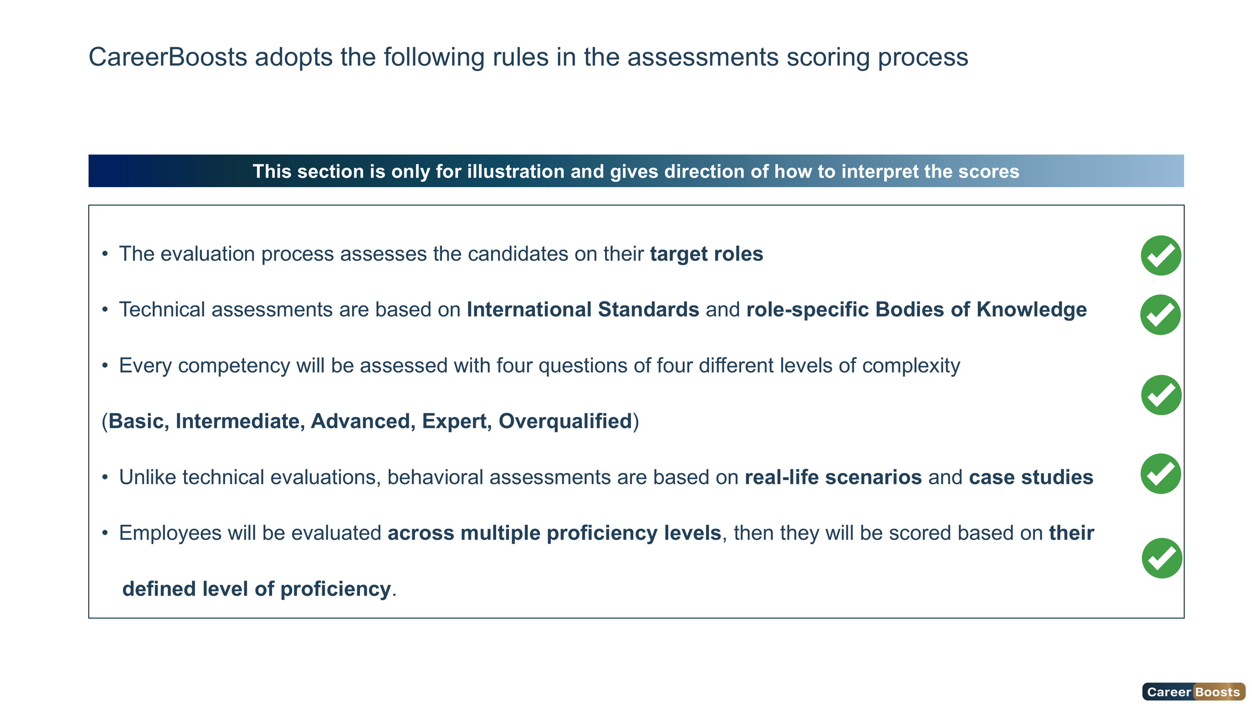
3

Slide 4
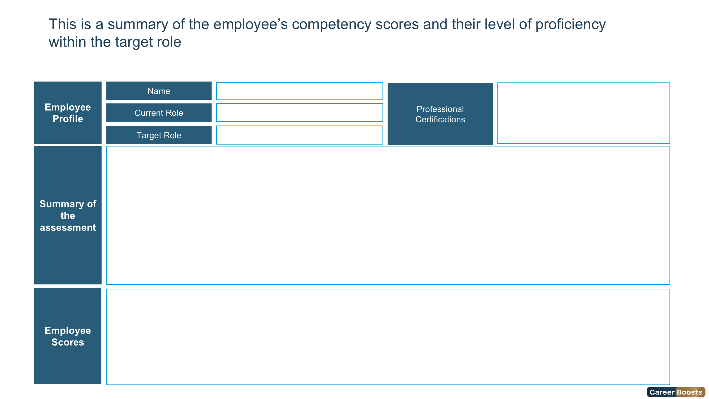

Foundation
Intermediate
Advanced
Expert
Overqualified
Advanced
Information not provided
Overall Score
Leadership Score
Technical Score
Behavioral Score
Cognitive Score
Personality Score
54%
73%
89%
93%
86%
80%
4

Slide 5
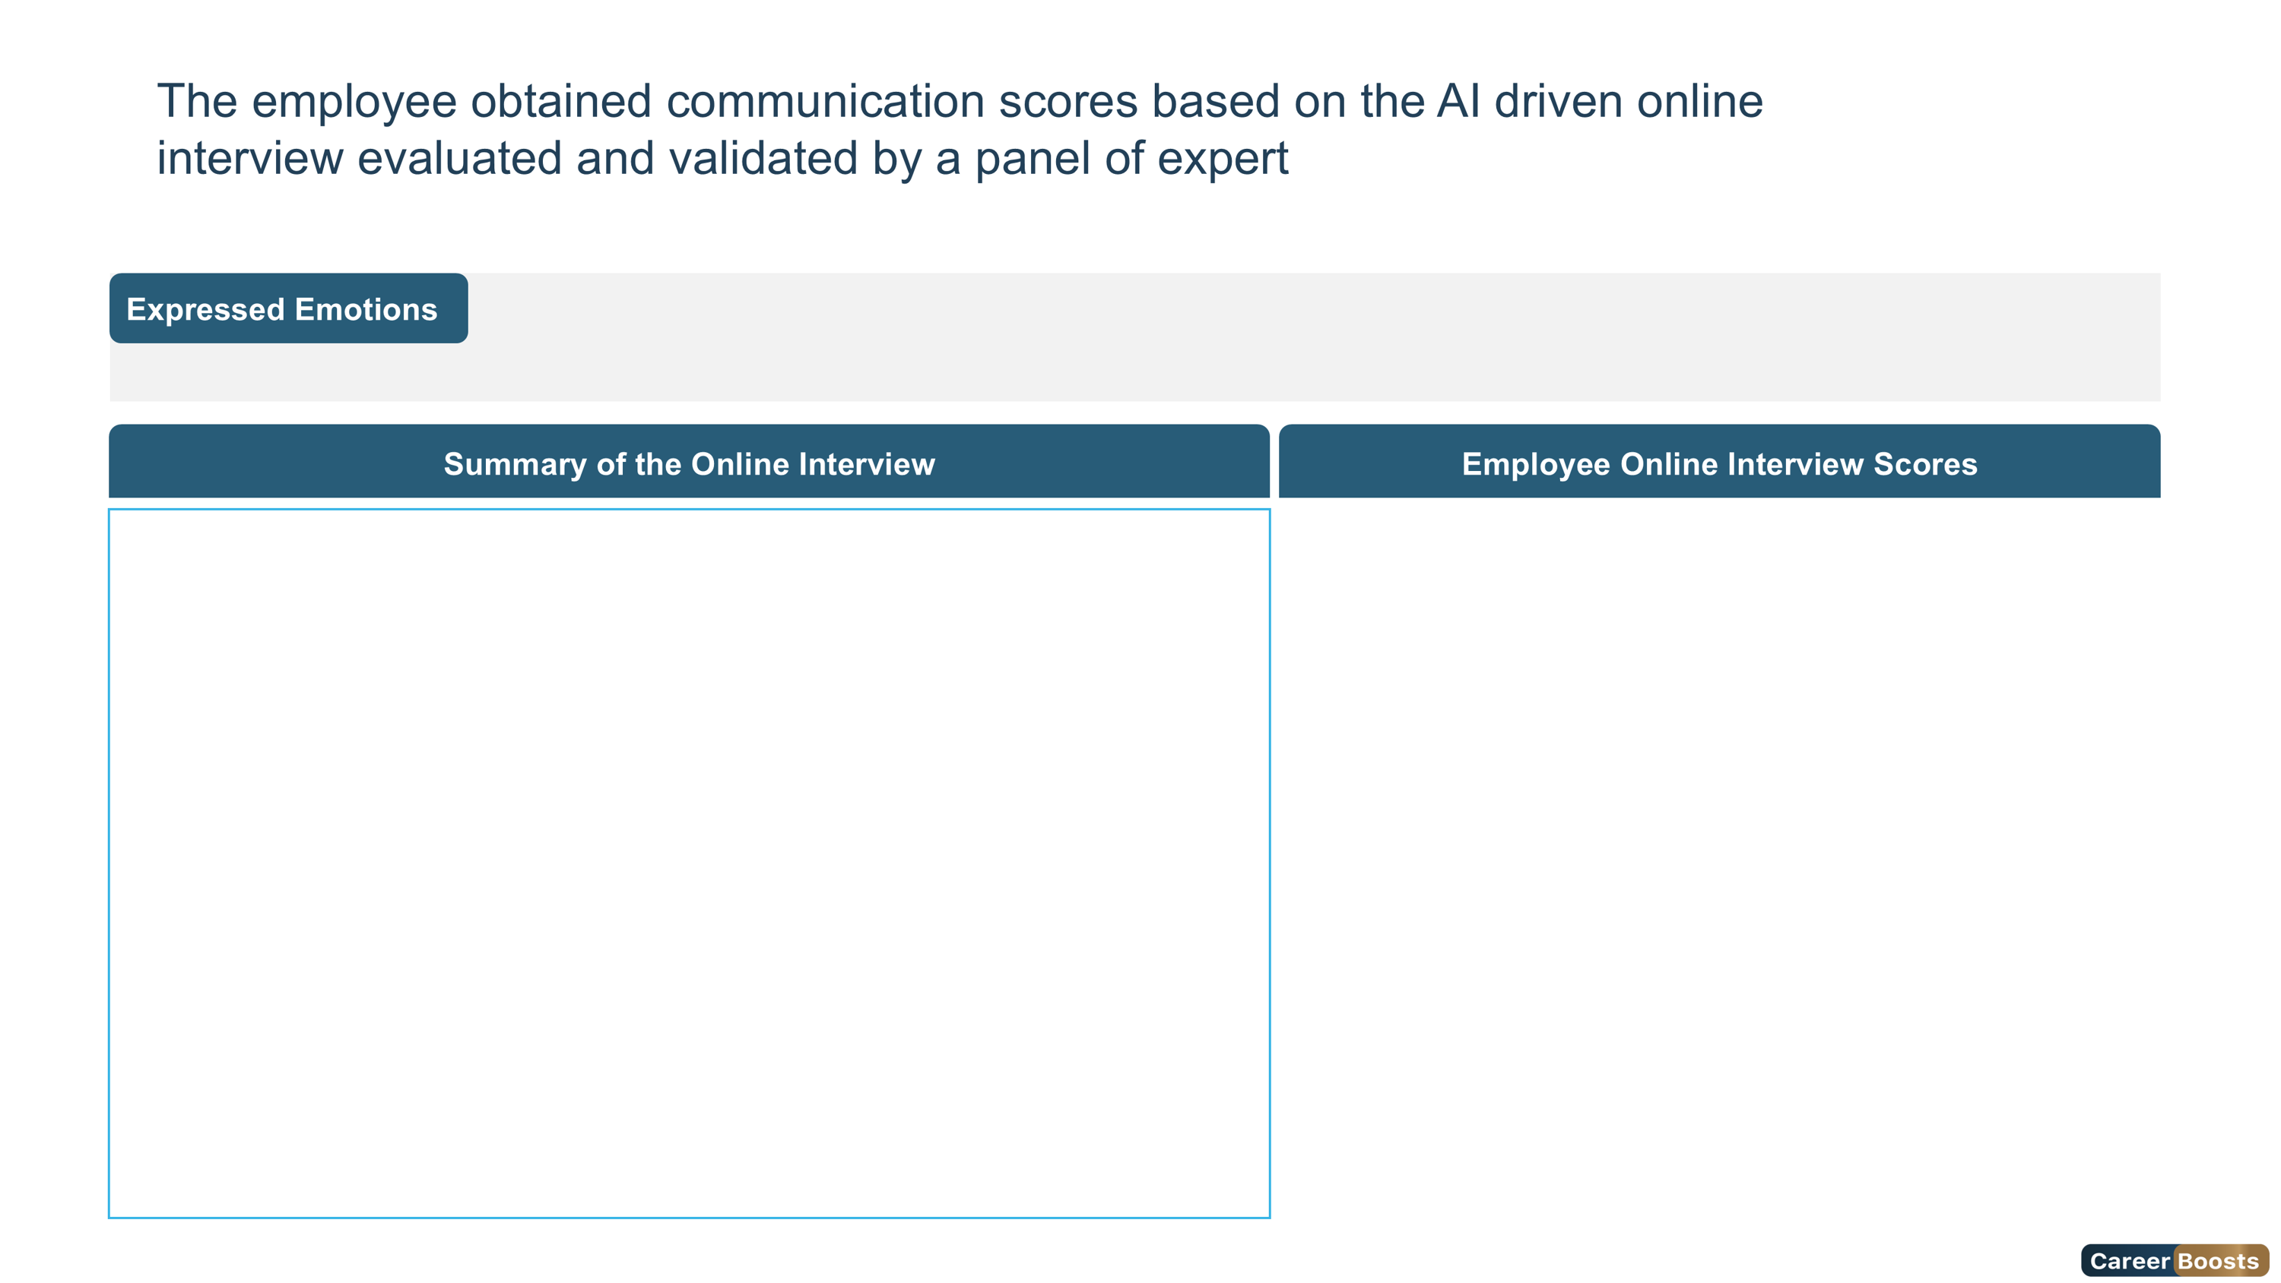


Joy
Surprise
Neutral
Sad
Fear
Angry
Disgust
5

Slide 6
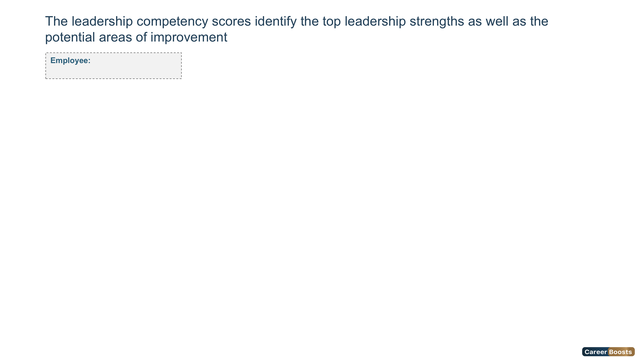
Foundation
Intermediate
Advanced
Expert
Overqualified
Advanced
Ms. ahlem masouad
Leadership Competencies Scores
6

Slide 7
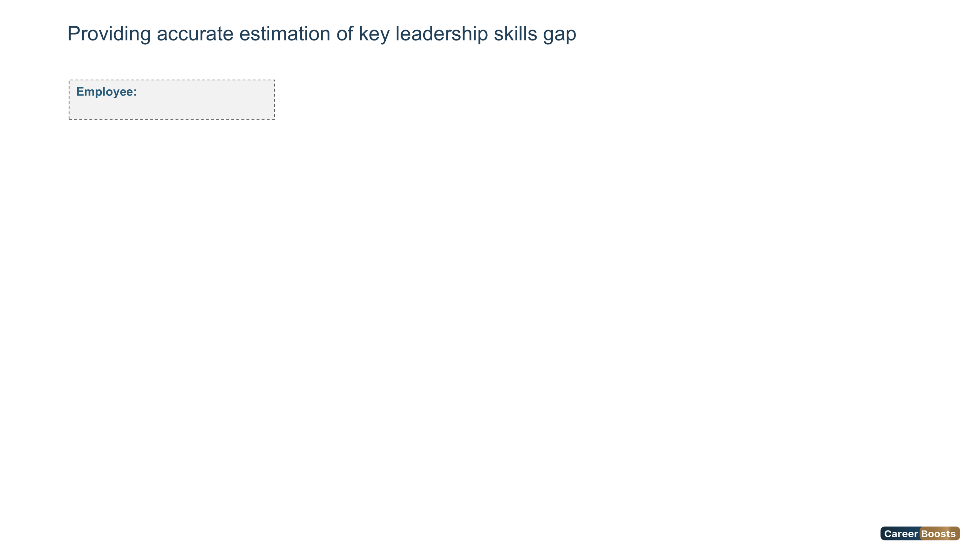
Foundation
Intermediate
Advanced
Expert
Overqualified
Advanced
Ms. ahlem masouad
7

Slide 8
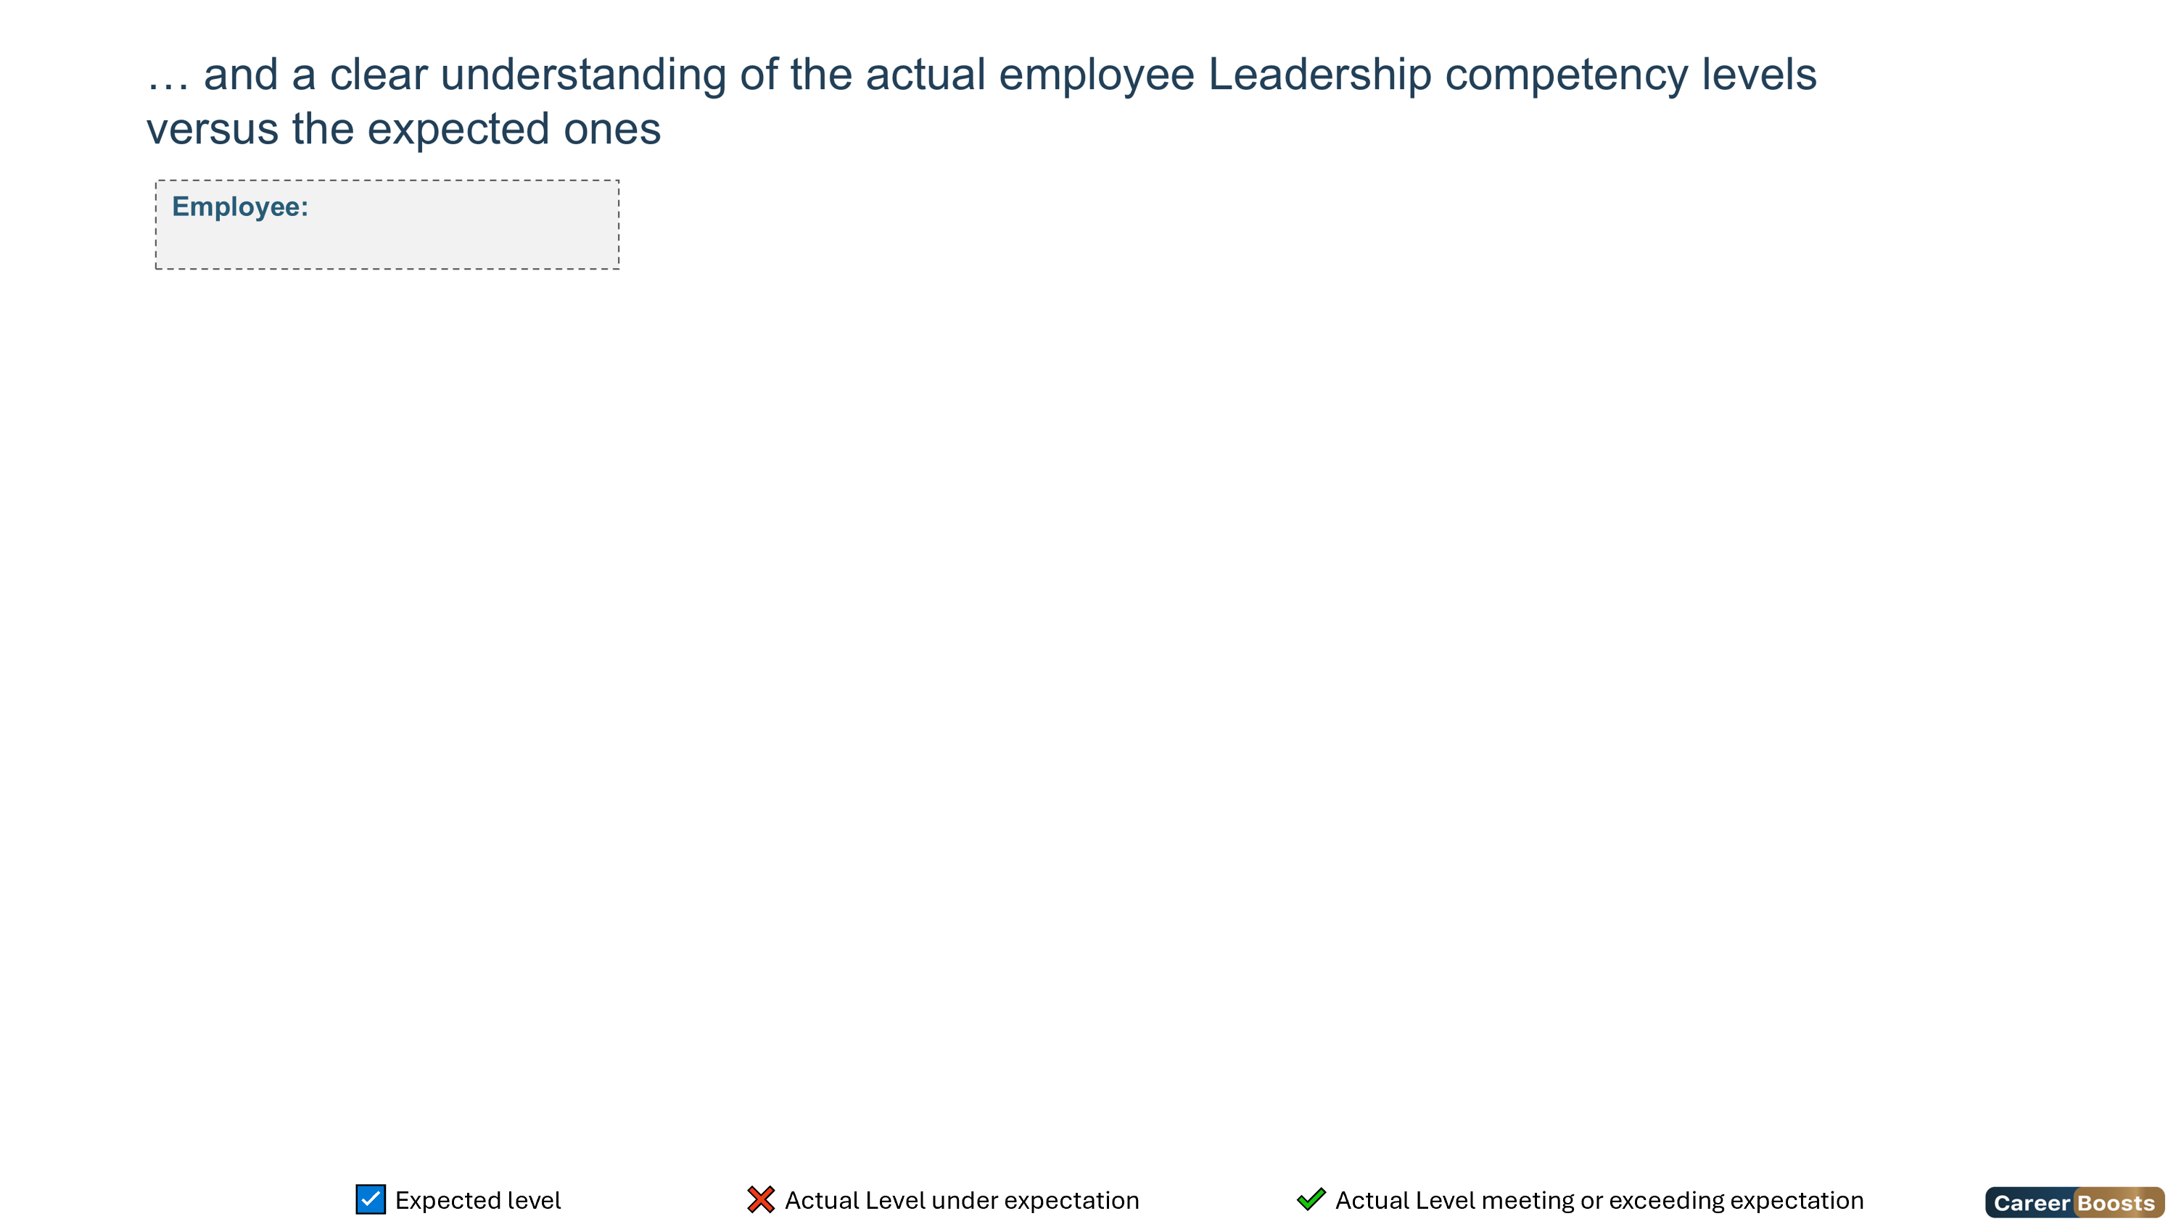
Foundation
Intermediate
Advanced
Expert
Overqualified
Advanced
Ms. ahlem masouad
Competency Name | Foundation | Intermediate | Advanced | Expert | Overqualified
8

Slide 9
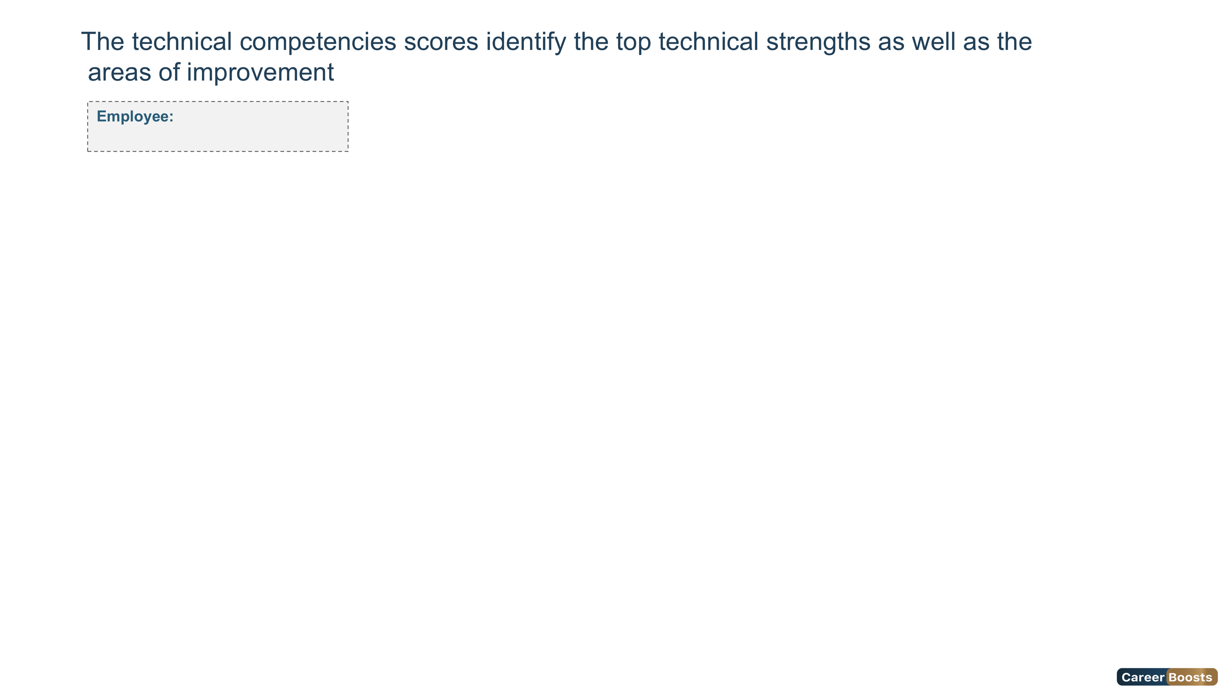
Foundation
Intermediate
Advanced
Expert
Overqualified
Advanced
Ms. ahlem masouad
Technical Competencies Scores
9

Slide 10
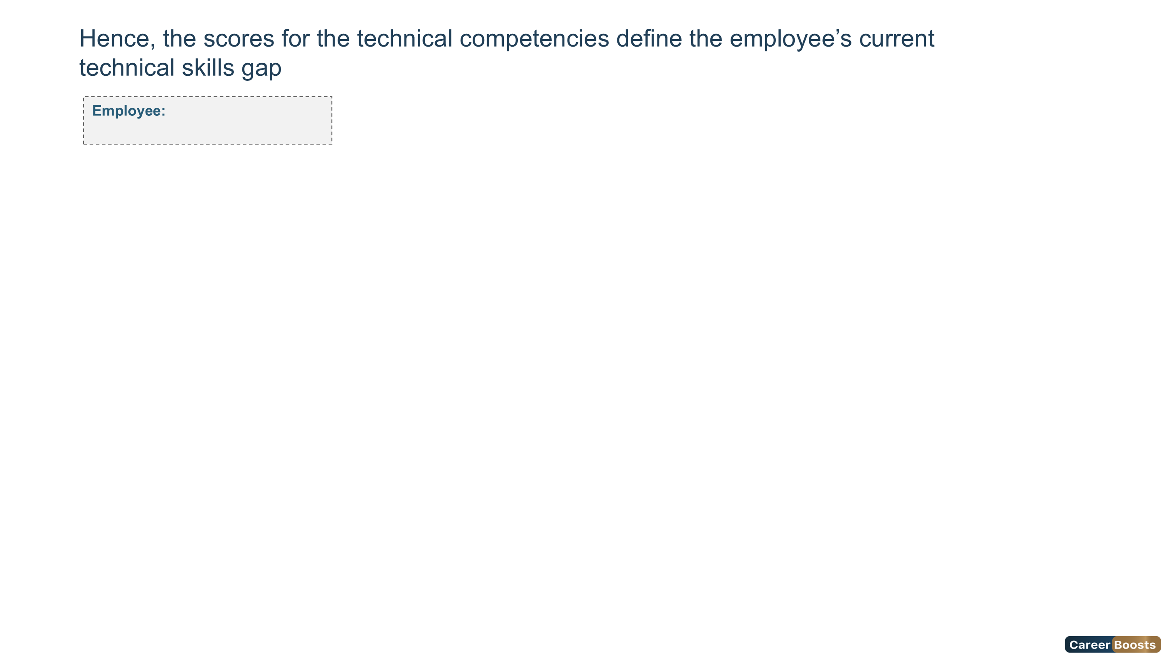
Foundation
Intermediate
Advanced
Expert
Overqualified
Advanced
Ms. ahlem masouad
10

Slide 11

Foundation
Intermediate
Advanced
Expert
Overqualified
Advanced
Ms. ahlem masouad
Competency Name | Foundation | Intermediate | Advanced | Expert | Overqualified
11

Slide 12
Foundation
Intermediate
Advanced
Expert
Overqualified
Advanced
Ms. ahlem masouad
Competency Name | Foundation | Intermediate | Advanced | Expert | Overqualified
12

Slide 13
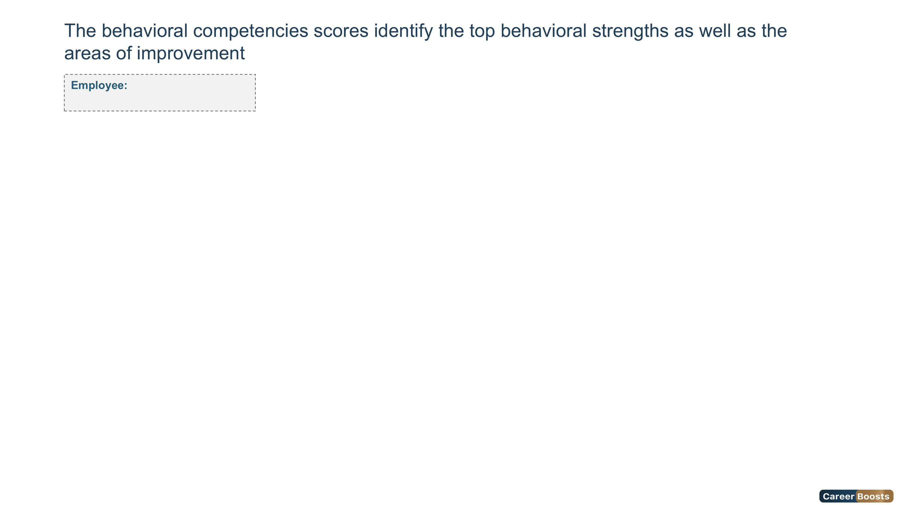
Foundation
Intermediate
Advanced
Expert
Overqualified
Advanced
Ms. ahlem masouad
Behavioral Competencies Scores
13

Slide 14

Foundation
Intermediate
Advanced
Expert
Overqualified
Advanced
Ms. ahlem masouad
14

Slide 15

Foundation
Intermediate
Advanced
Expert
Overqualified
Advanced
Ms. ahlem masouad
Competency Name | Foundation | Intermediate | Advanced | Expert | Overqualified
15

Slide 16
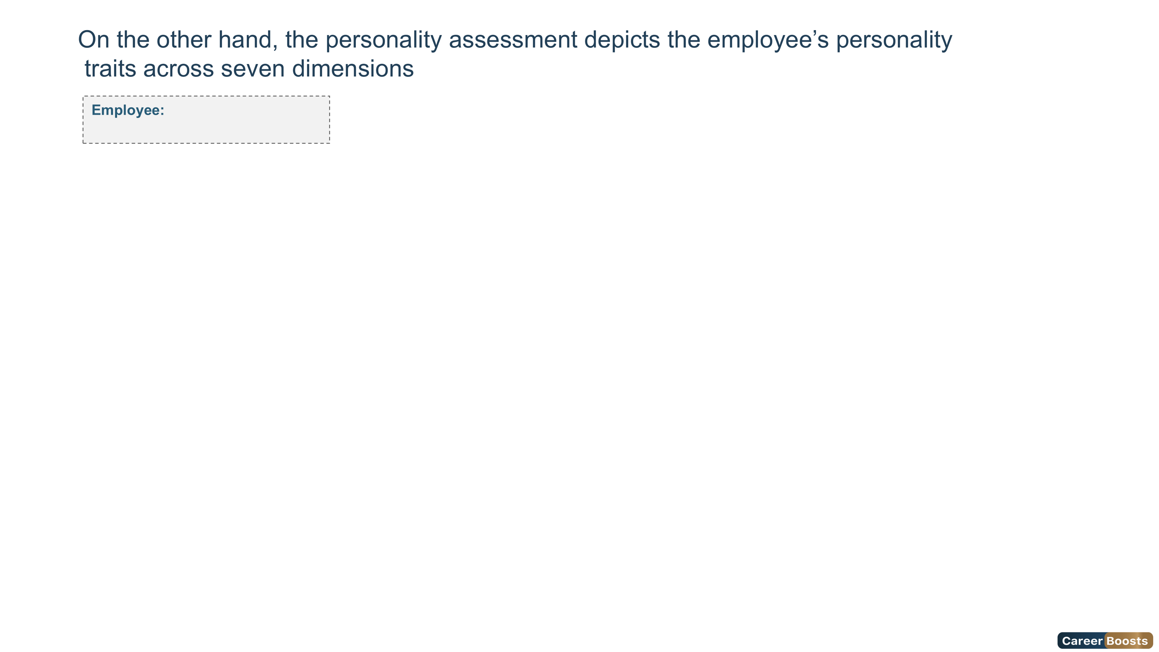
Ms. ahlem masouad
HPI - Personality Scale
16

Slide 17
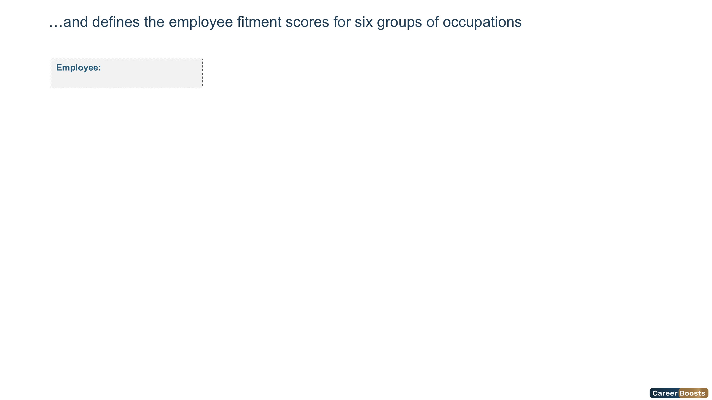
Ms. ahlem masouad
HPI - Professional Scale
96%
98%
96%
95%
64%
90%
Managerial Potential
Stress Tolerance
Service Orientation
Clerical Potential
Sales Potential
Reliability
17

Slide 18
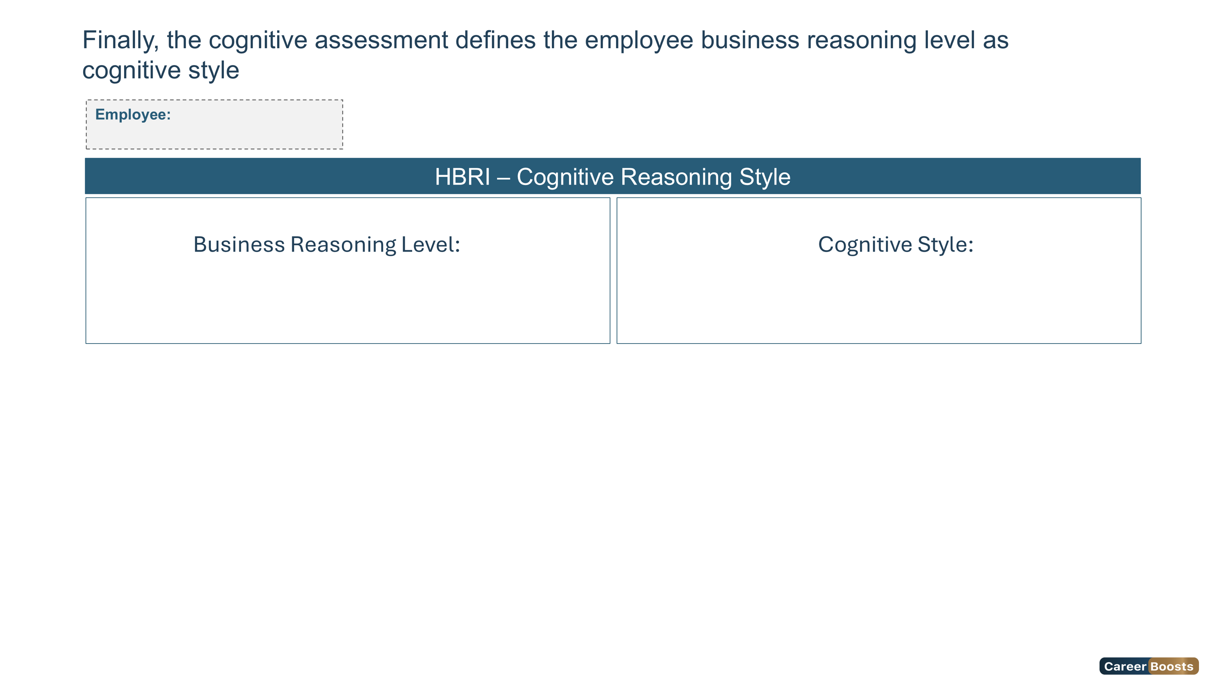
Ms. ahlem masouad
Low
Contextual
100%
83%
75%
Quantitative Reasoning
Business Reasoning
Qualitative Reasoning
18

Slide 19
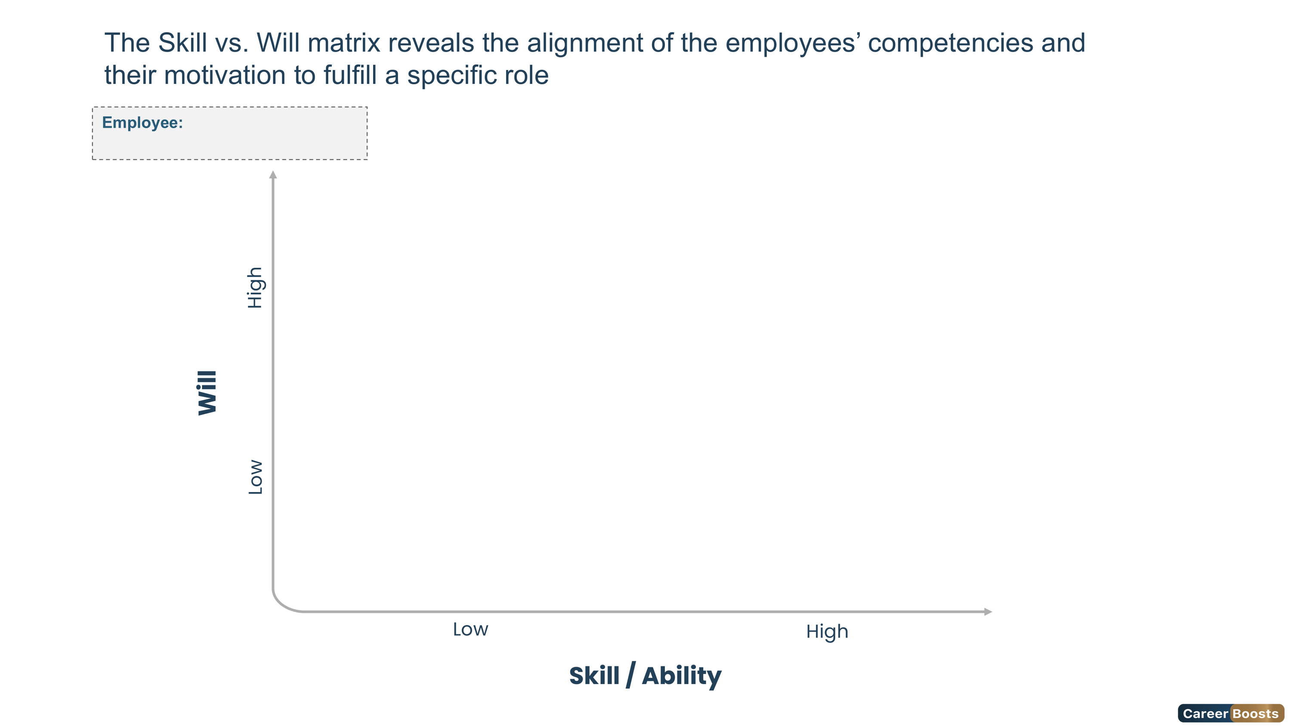


Ms. ahlem masouad
Low Skill / High Will
Guide
High Skill / High Will
Delegate
Low Skill / Low Will
Direct
High Skill / Low Will
Excite
19

Slide 20
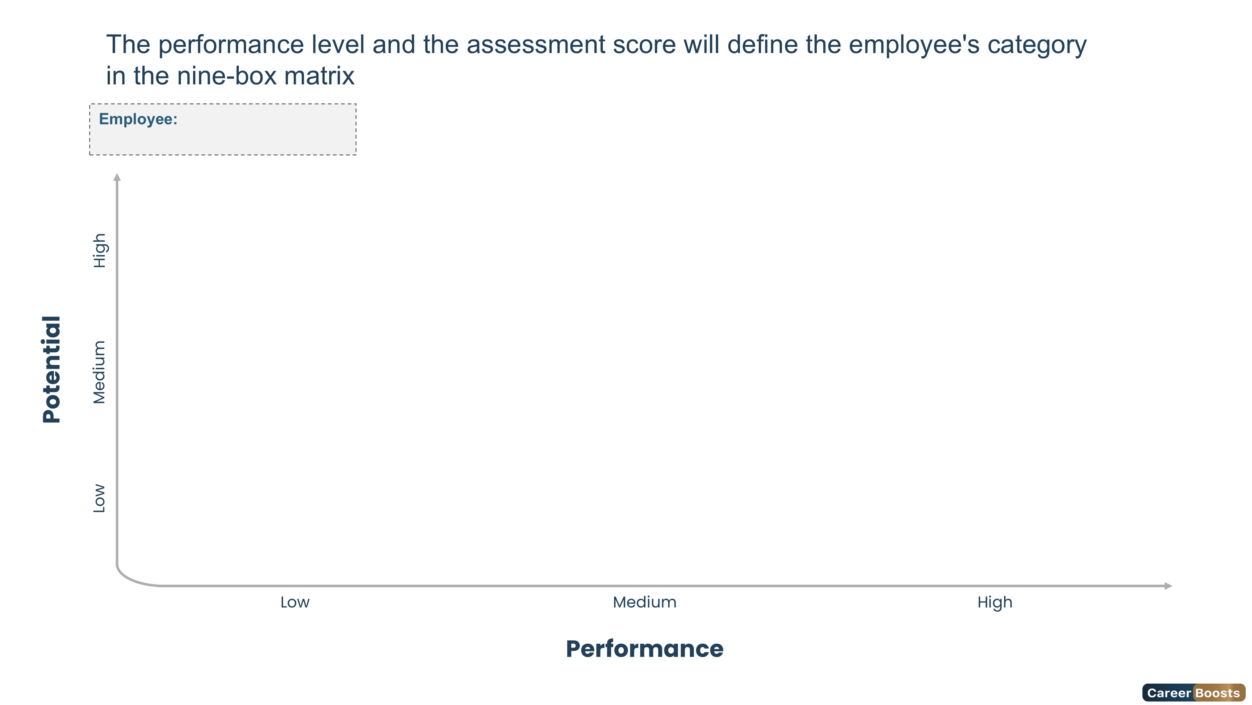


Ms. ahlem masouad
Long-Term Potential
Future Leader
Outstanding Leader
Marginal Contributor
Solid Contributor
Stretch Potential
Underperformer
Sound Contributor
Seasoned Professional
20

Slide 21
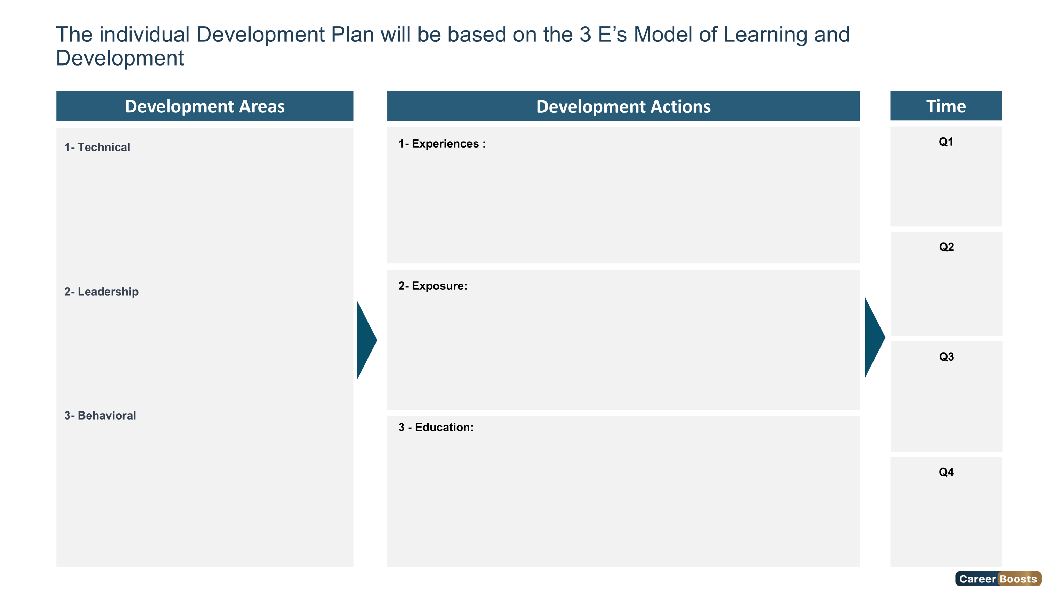
21

Slide 22
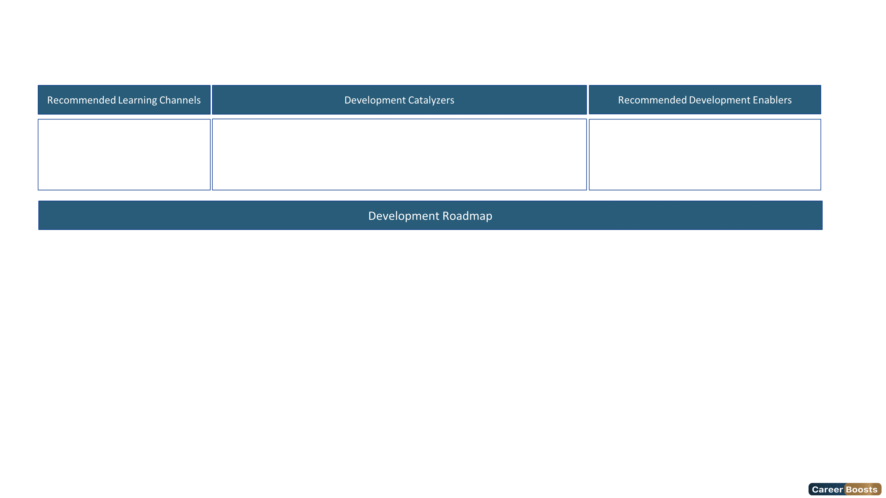
Based on the evaluation results, Ms. masouad will benefit from a development plan to reach the "Expert Level" of this role
Key Trainings | M1 | M2 | M3 | M4 | M5 | M6 | M7 | M8 | M9 | M10 | M11 | M12
Certified Information Security Manager | ★
Certified Threat Intelligence Analyst |  |  |  | ★
Certified in Risk and Information Systems Control (CRISC) |  |  |  |  | ★
22

Slide 23
